Slide 1
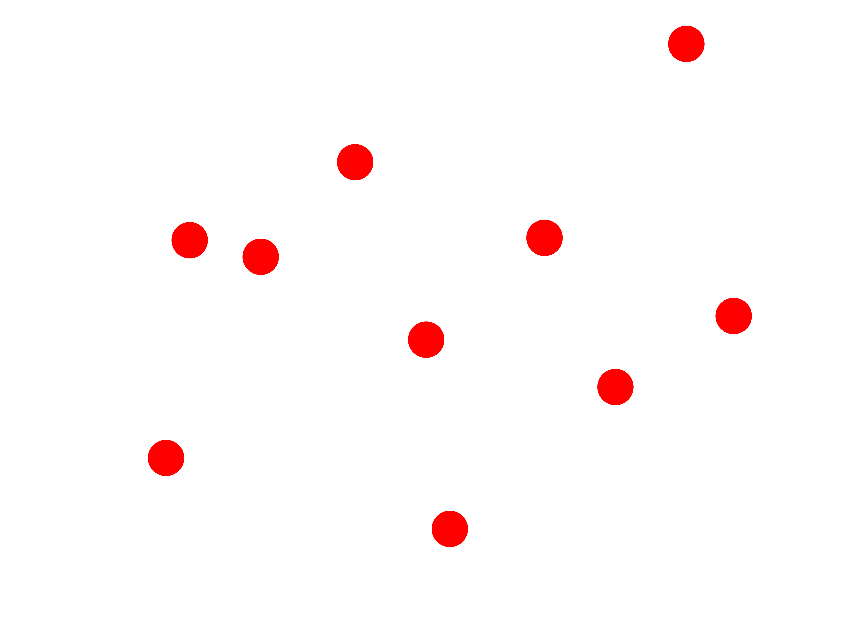
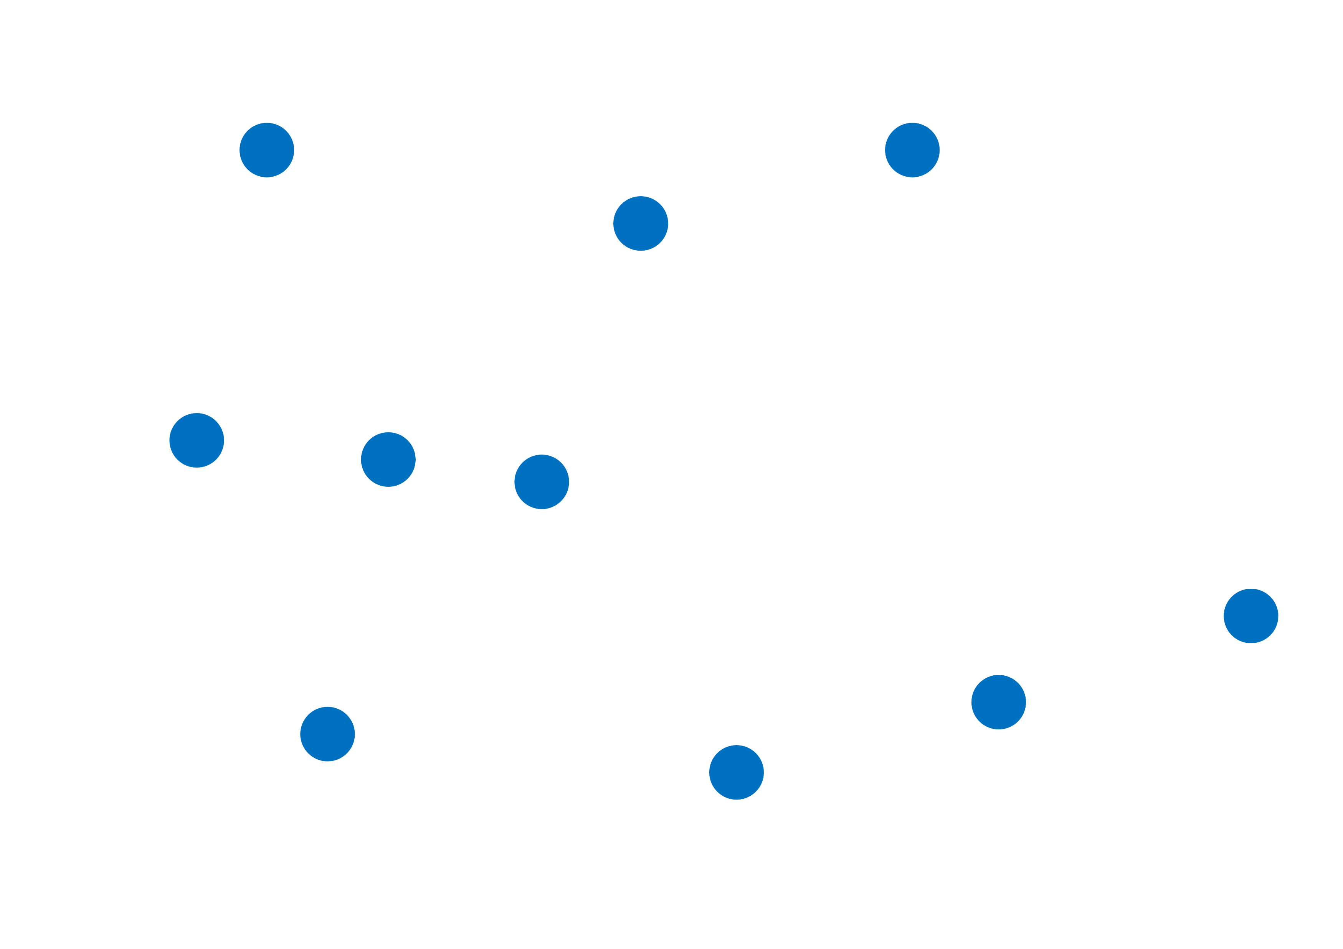

Slide 2
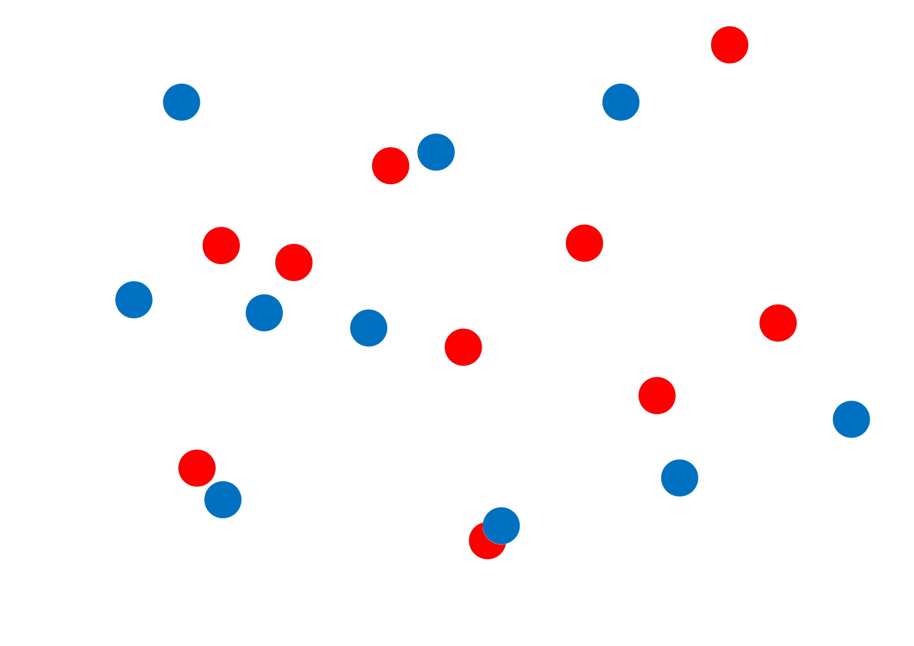
A3 Paper
15 mm Waypoints
297 mm
(0, 0)
Start Point
Marked Robot Outline
Waypoint Sheet 1
Waypoint Sheet 2
420 mm

Slide 3
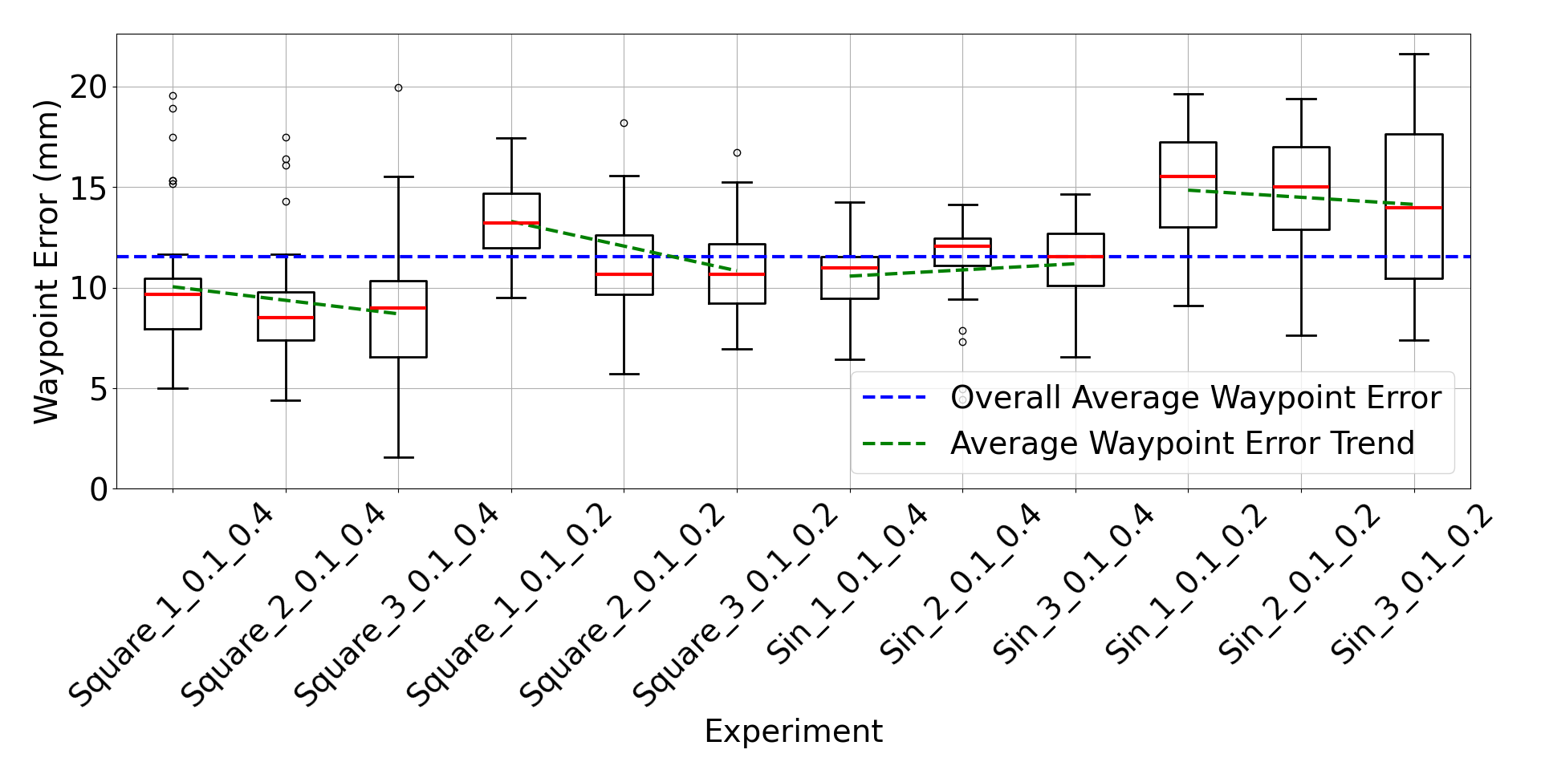

Slide 4
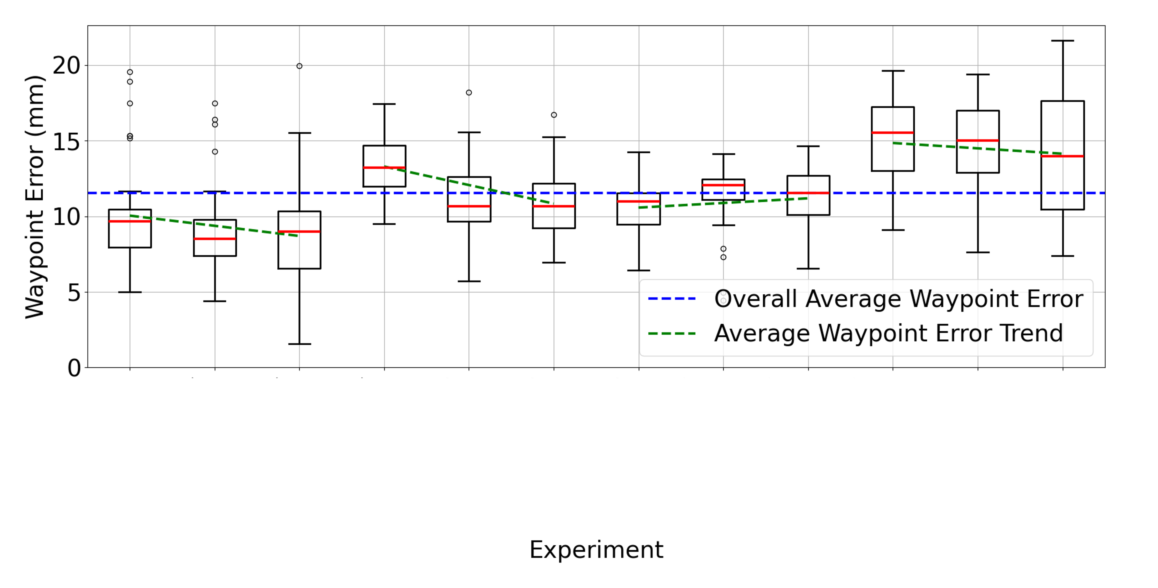
Speed | 1 | 2 | 3 | 1 | 2 | 3 | 1 | 2 | 3 | 1 | 2 | 3
Wavelength | 400 mm |  |  | 200 mm |  |  | 400 mm |  |  | 200 mm
Search | Square Wave |  |  |  |  |  | Sine Wave

Slide 5
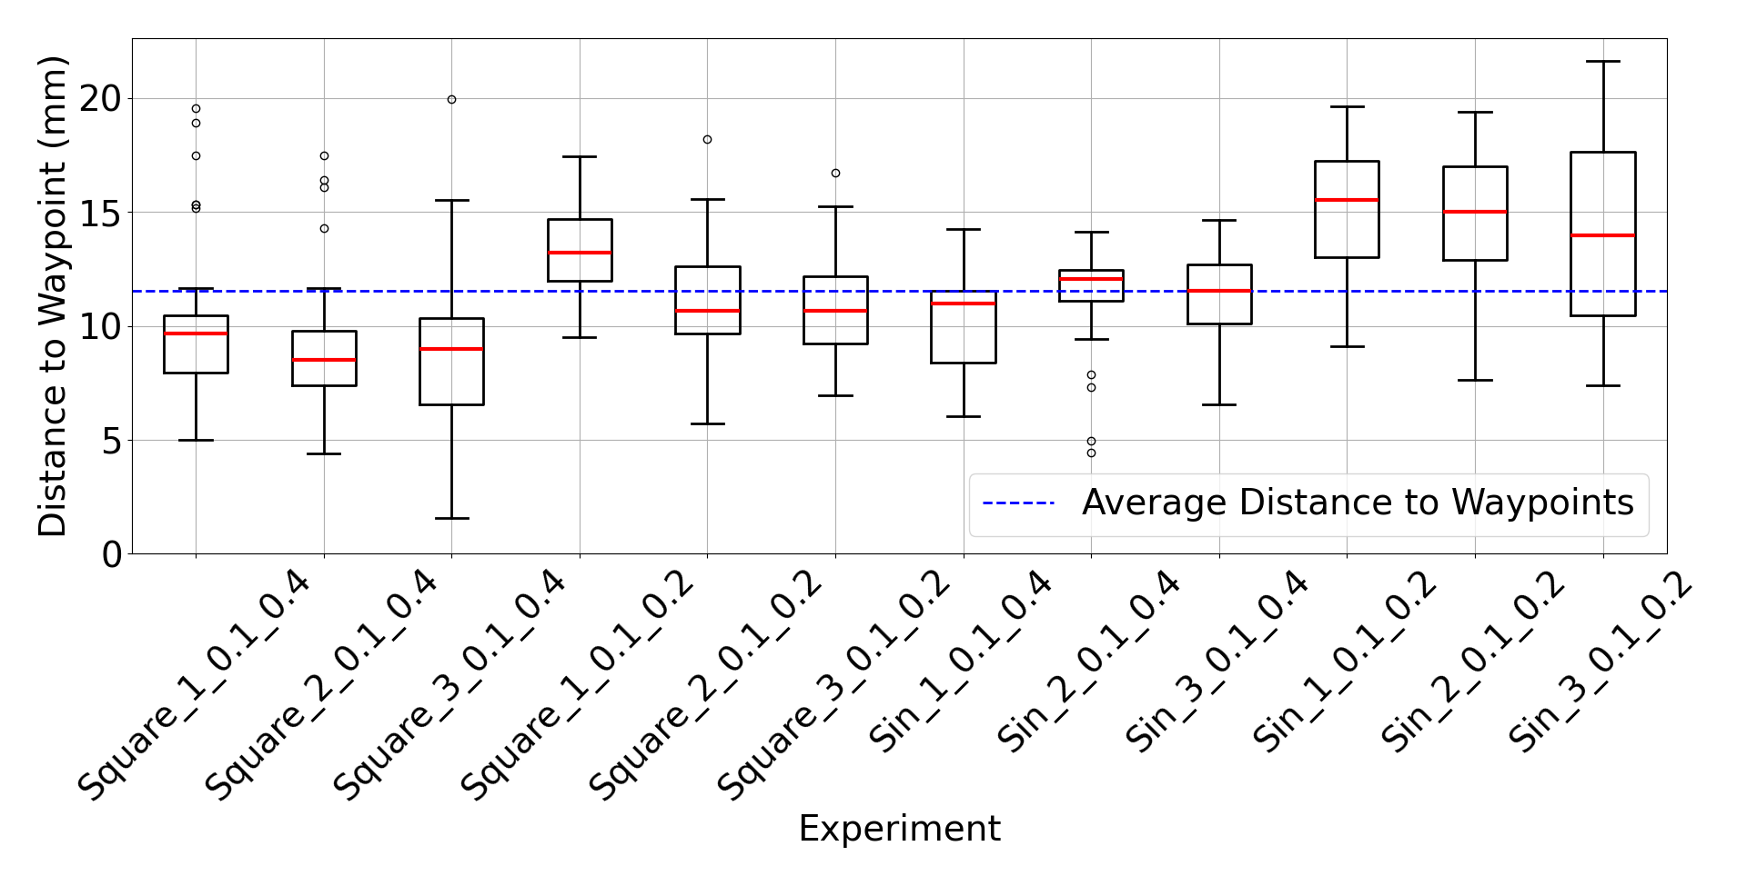

Slide 6
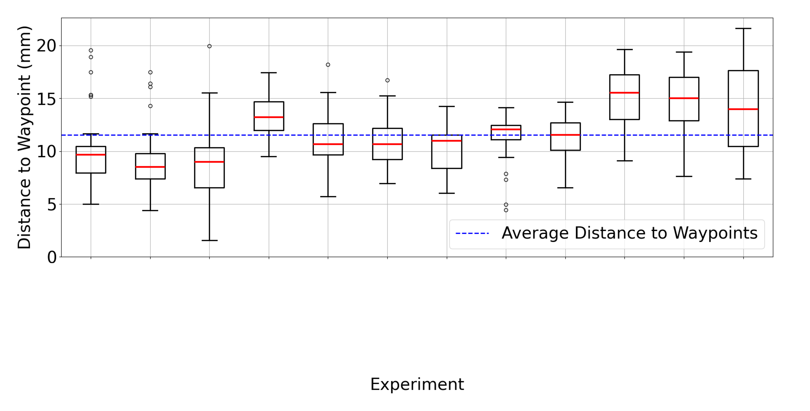
Speed | 1 | 2 | 3 | 1 | 2 | 3 | 1 | 2 | 3 | 1 | 2 | 3
Wavelength | 400 mm |  |  | 200 mm |  |  | 400 mm |  |  | 200 mm
Search | Square Wave |  |  |  |  |  | Sine Wave

Slide 7
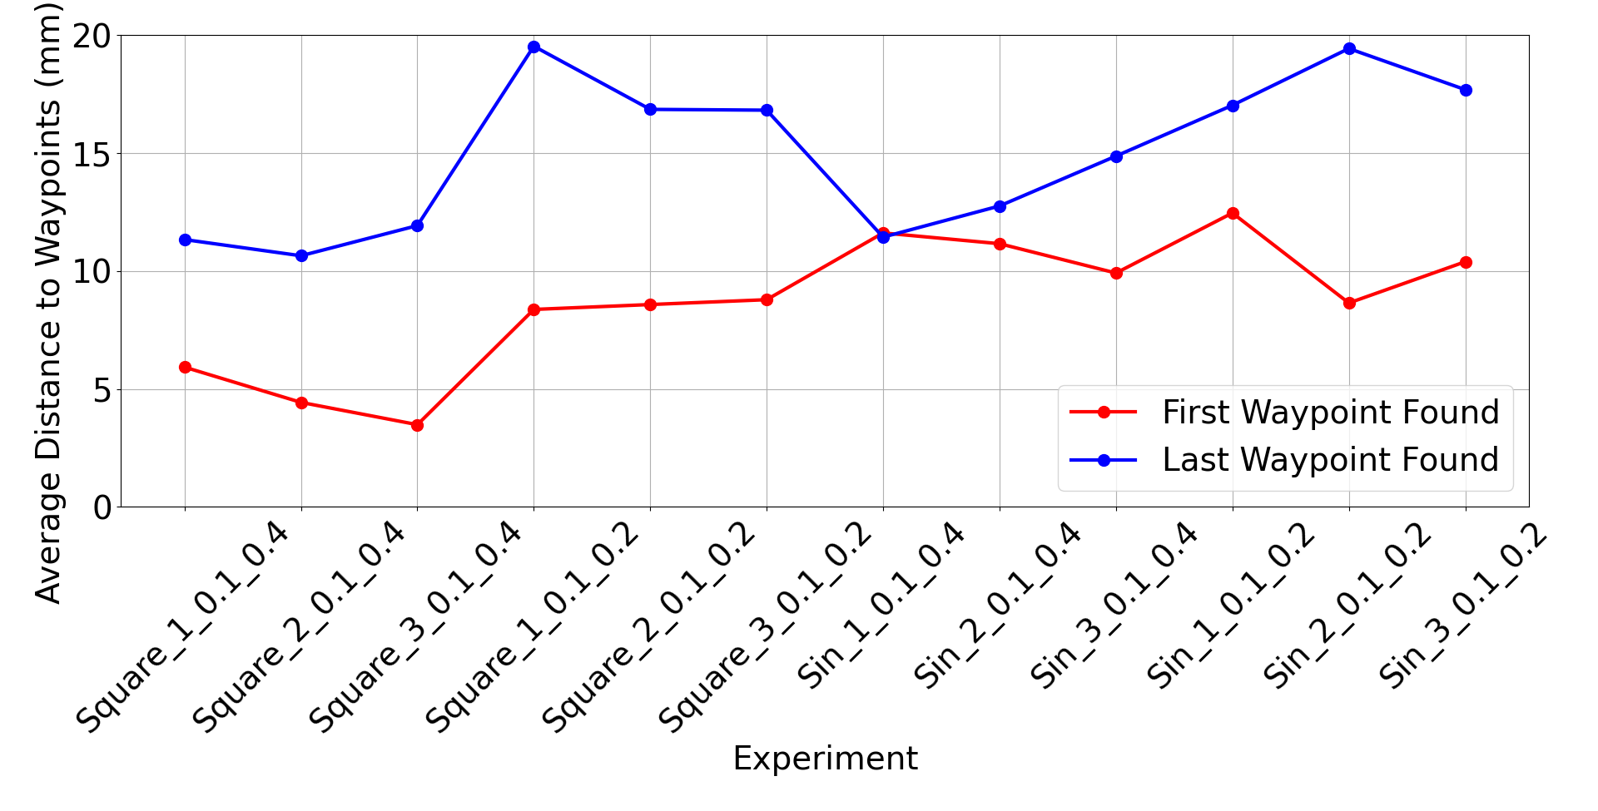

Slide 8
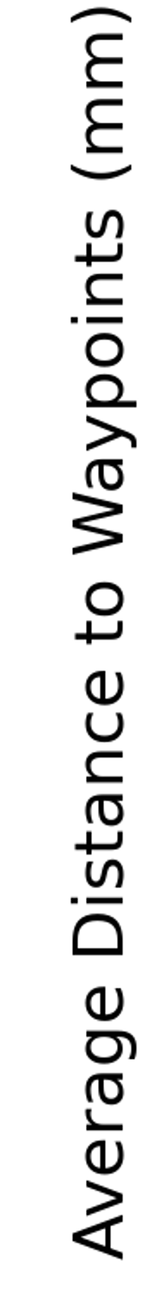
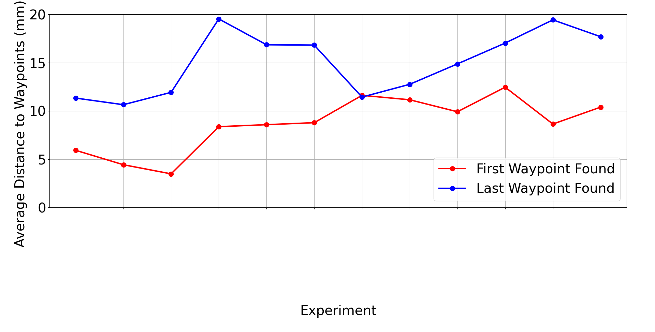
Speed | 1 | 2 | 3 | 1 | 2 | 3 | 1 | 2 | 3 | 1 | 2 | 3
Wavelength | 400 mm |  |  | 200 mm |  |  | 400 mm |  |  | 200 mm
Search | Square Wave |  |  |  |  |  | Sine Wave

Slide 9
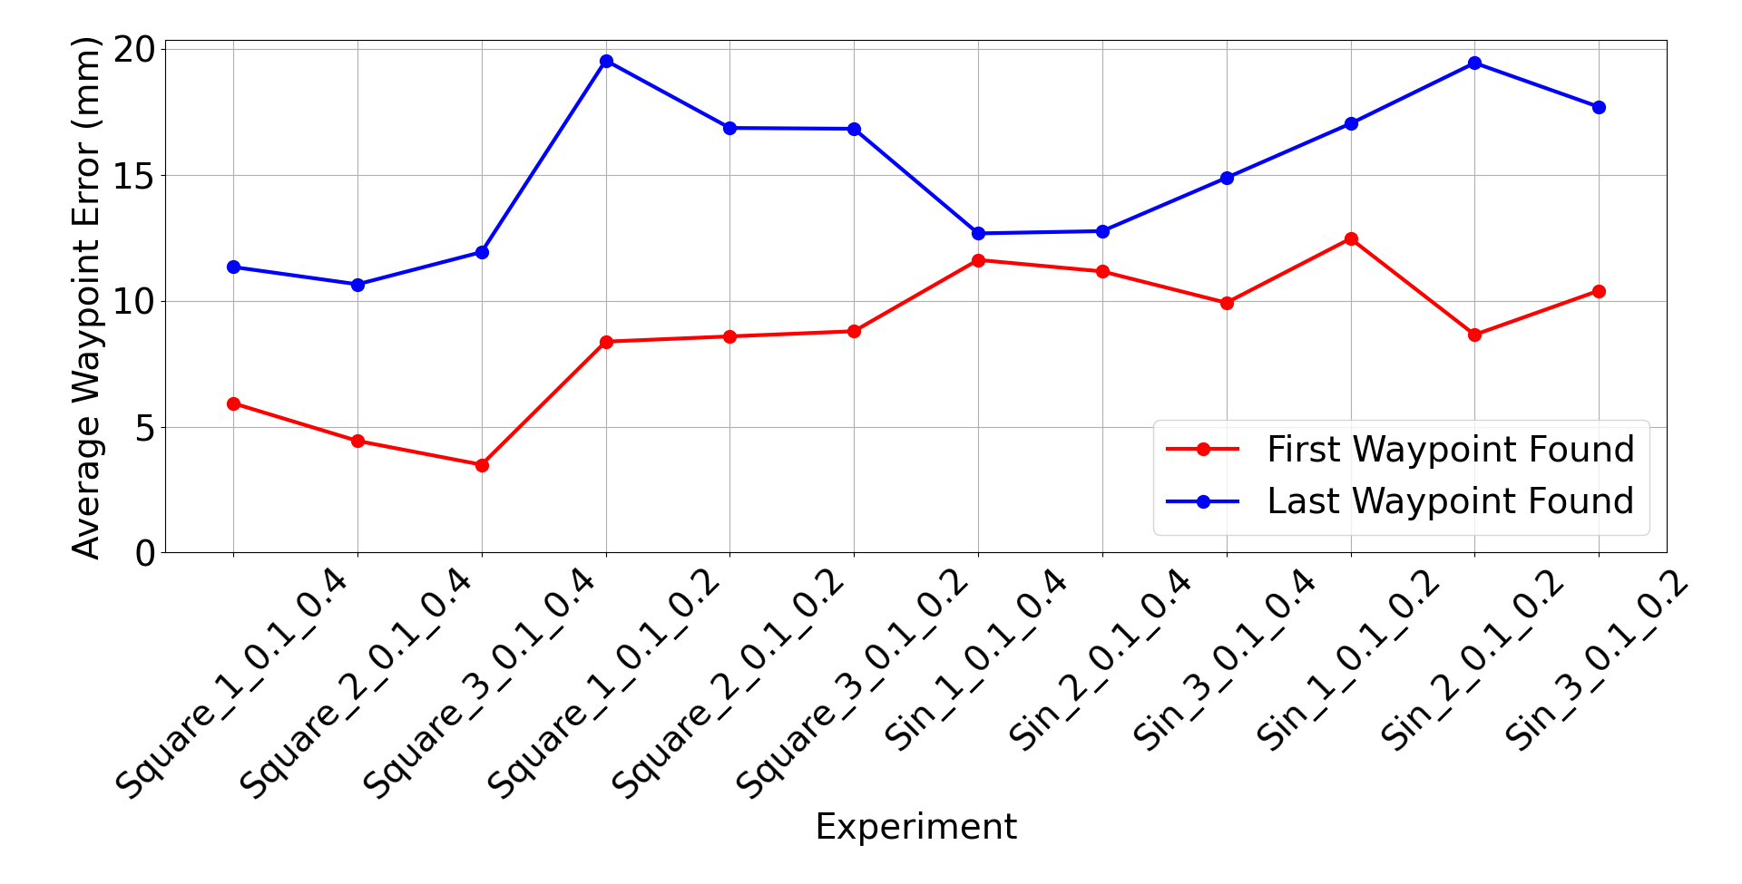

Slide 10
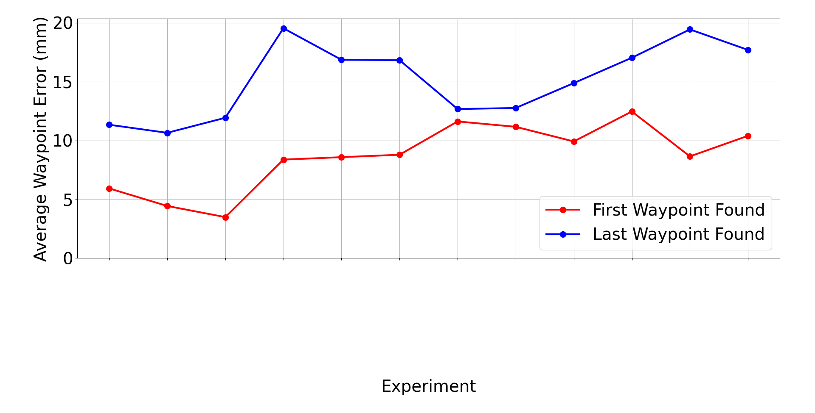
Speed | 1 | 2 | 3 | 1 | 2 | 3 | 1 | 2 | 3 | 1 | 2 | 3
Wavelength | 400 mm |  |  | 200 mm |  |  | 400 mm |  |  | 200 mm
Search | Square Wave |  |  |  |  |  | Sine Wave

Slide 11
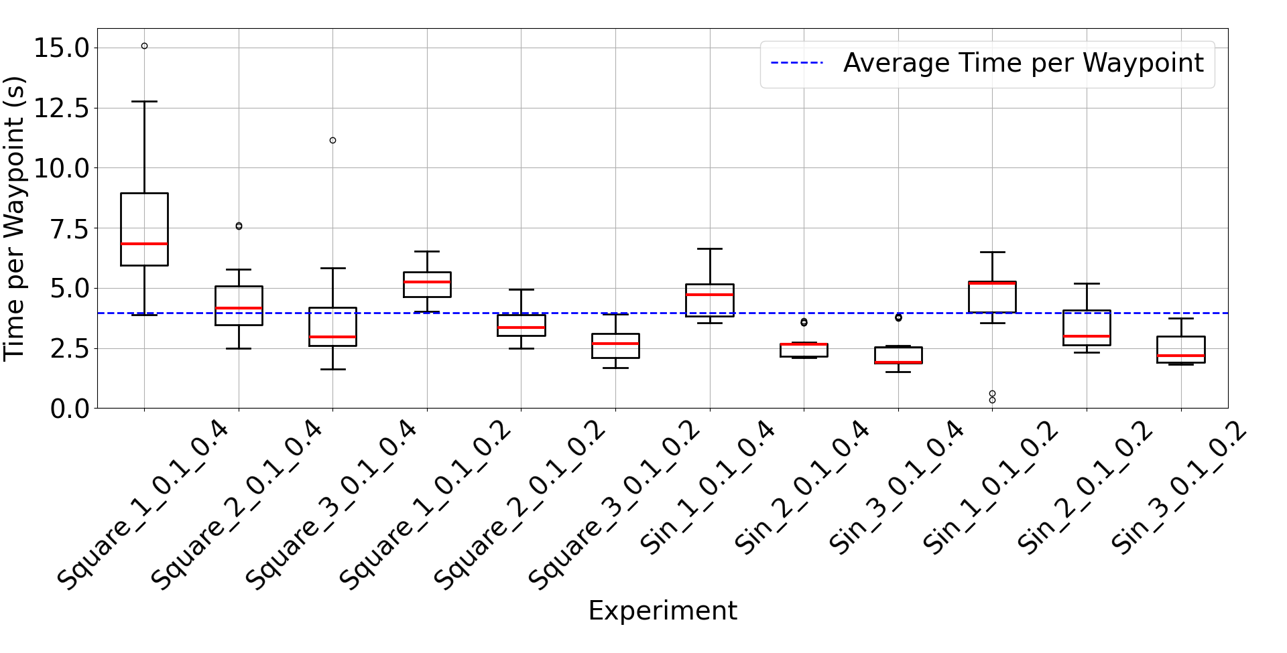

Slide 12
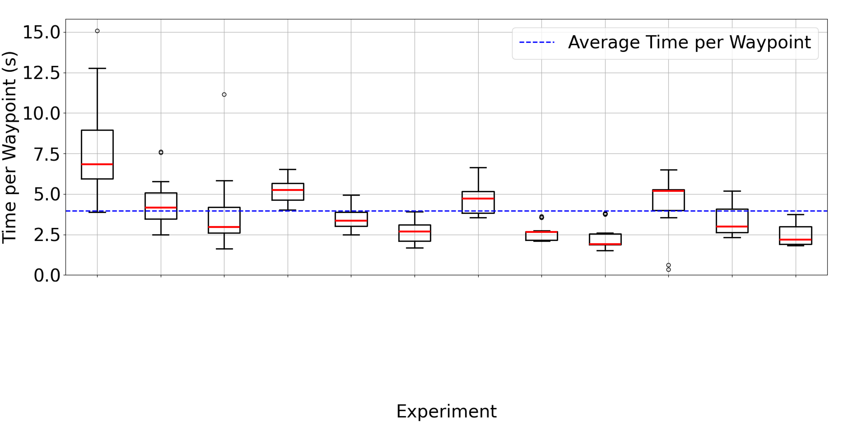
Speed | 1 | 2 | 3 | 1 | 2 | 3 | 1 | 2 | 3 | 1 | 2 | 3
Wavelength | 400 mm |  |  | 200 mm |  |  | 400 mm |  |  | 200 mm
Search | Square Wave |  |  |  |  |  | Sine Wave

Slide 13
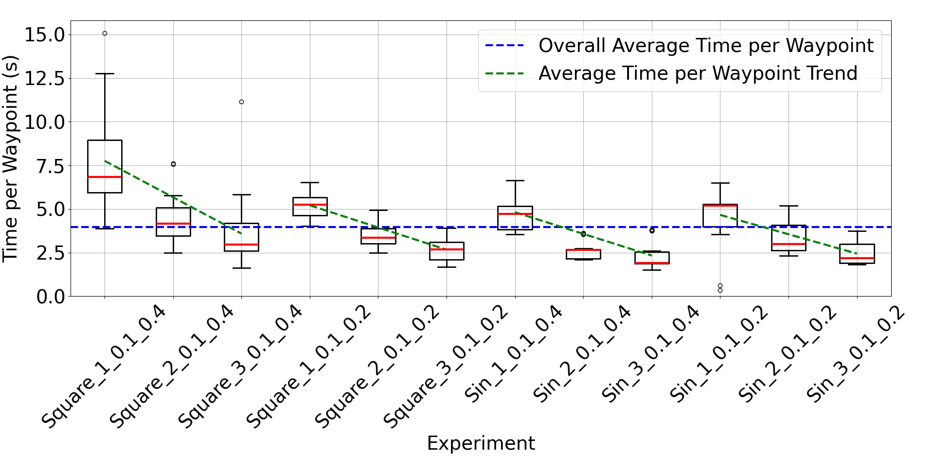

Slide 14
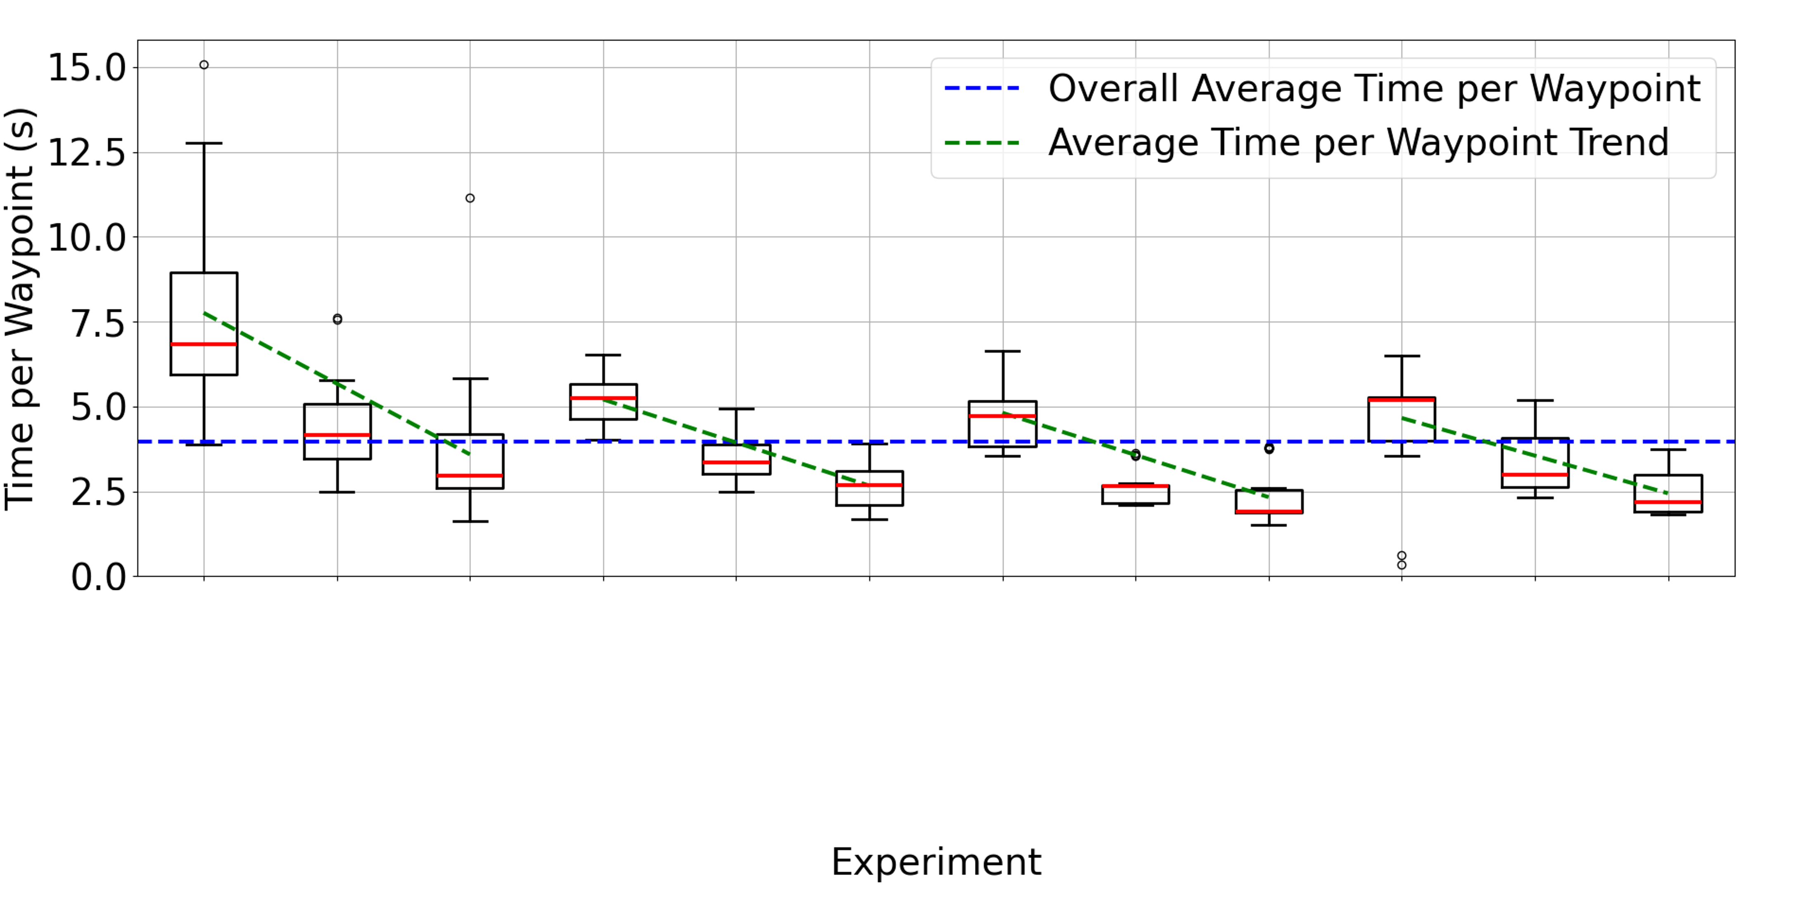
Speed | 1 | 2 | 3 | 1 | 2 | 3 | 1 | 2 | 3 | 1 | 2 | 3
Wavelength | 400 mm |  |  | 200 mm |  |  | 400 mm |  |  | 200 mm
Search | Square Wave |  |  |  |  |  | Sine Wave

Slide 15
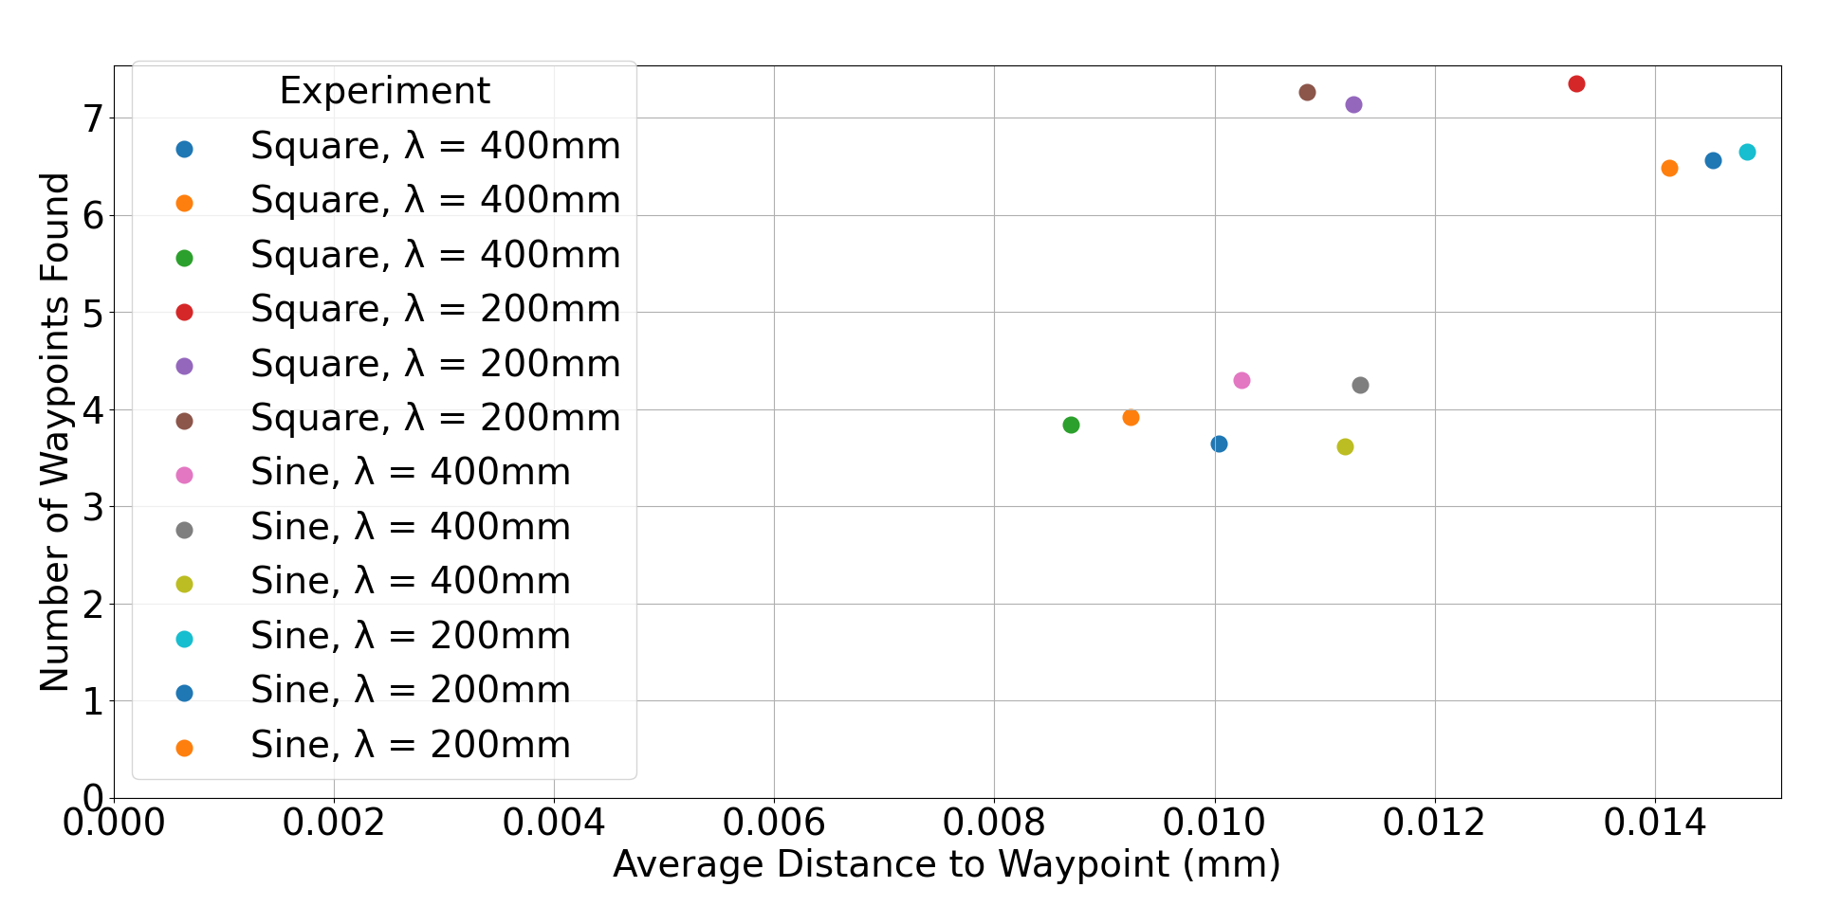
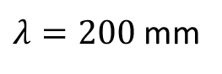
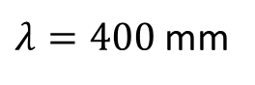
$λ=200$ mm
$λ=400$ mm

Slide 16
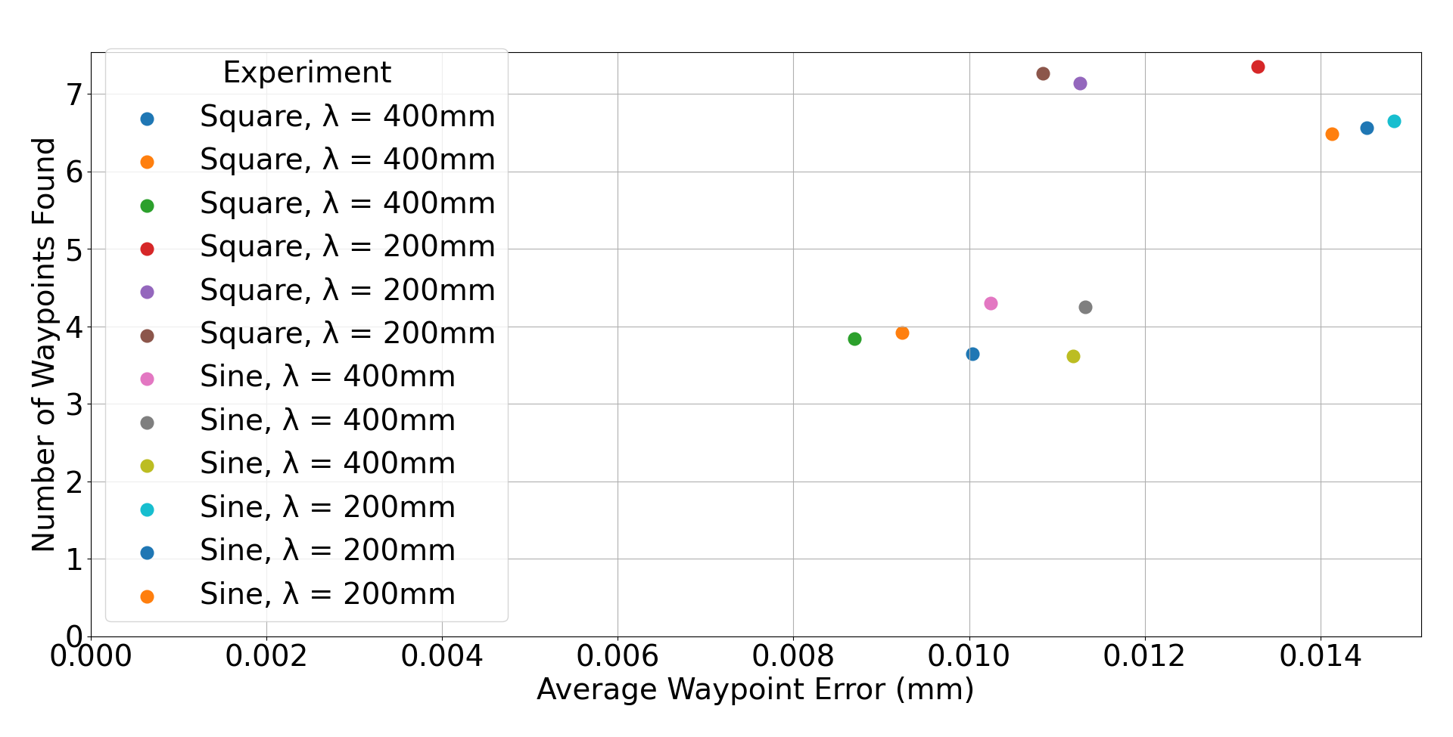
$λ=200$ mm
$λ=400$ mm

